Slide 1

An Evolution in Standards Supporting
Specialty Medication Workflow
Pharmacy Informatics Town Hall
December 12, 2020

Slide 2



As a mission-driven non-profit, HIMSS offers a unique depth and breadth of expertise in health innovation, public policy, workforce development, research and analytics to advise global leaders, stakeholders and influencers on best practices in health information and technology.
HIMSS is a global advisor and thought leader supporting the transformation of the health ecosystem through information and technology.
With more than 350 employees, HIMSS has operations in:
North America | Asia Pacific | Europe | Latin America | Middle East | United Kingdom

Slide 3





Vision
Mission
To realize the full health
potential of every human, everywhere.
Reform the global health ecosystem through the power of information and technology.

Slide 4

About NCPDP
Founded in 1977, NCPDP is a not-for-profit, ANSI-accredited, Standards Development Organization with over 1,500 members representing virtually every sector of the pharmacy services industry.
NCPDP members have created standards such as the Telecommunication Standard and Batch Standard, the SCRIPT Standard for e-Prescribing, the Manufacturers Rebate Standard and more to improve communication within the pharmacy industry.
Our data products include dataQ®, a robust database of information on more than 80,000 pharmacies, HCIdea®, a database of continually updated information on more than 2.5 million prescribers, and resQ™, an industry pharmacy credentialing resource. NCPDP's RxReconn® is a legislative tracking product for real-time monitoring of pharmacy-related state and national legislative and regulatory activity.
www.ncpdp.org

Slide 5


Accreditation Statement
The Institute for Wellness and Education, Inc., is accredited by the Accreditation Council for Pharmacy Education (ACPE) as a provider of continuing pharmacy education. Participants of the session who complete the evaluation and provide accurate CPE Monitor e-Profile information will have their credit for 1.0 contact hours (0.10 CEU) submitted to CPE Monitor within 60 days of the event.
Please know that if accurate CPE Monitor e-Profile number is not provided within 60 days of the event, credit cannot be claimed after that time.
ACPE program numbers are:
0459-0000-20-042-H04-P and 0459-0000-20-042-H04-T
Release Date: December 10, 2020

Slide 6


Julie Hessick, R.Ph.
Senior Director, Business Development
OneOme
Julie is a registered pharmacist in 12 states, certified in pharmacogenomics with over 20 years experience in Specialty, Managed Care and Healthcare Technology.
She currently is the Senior Director of Business Development at OneOme where she specializes in helping organizations implement pharmacogenomic programs that optimize medications and improve clinical and financial outcomes.
She is active in local and national pharmacy organizations including AMCP and NCPDP where she is the co-chair for WG 18, Specialty Pharmacy.

Slide 7

Laura Topor
President, Granada Health, Inc.
Laura Topor is President of Granada Health, Inc., a Minnesota-based consulting firm. Ms. Topor has over 25 years’ experience in pharmacy benefits management, payer and provider operations, health information technology, e-prescribing, regulatory compliance, process improvement, and strategic planning. She has worked with the Minnesota Department of Health, ONC, Johns Hopkins, Medtronic, PharmaSmart, BenMedica, PricewaterhouseCoopers, Allina, and HealthPartners. She is an active member of NCPDP, AMCP, MPhA and the Minnesota eHealth Initiative. At NCPDP, Laura has served as a member of the Board of Trustees, work group and standardization co-chair, and on numerous committees and task groups. She currently serves as co-chair of NCPDP’s Specialty Pharmacy Work Group.

Slide 8

Michele R. Kidd, PharmD
Senior Manager, Clinical Technology
Accredo Health Group
Michele is a residency-trained pharmacist with specialty and hospital pharmacy experience. She joined Accredo in 2006 and is currently the Senior Manager Clinical Technology. Michele has worked with and/or developed/implemented physician order entry, system driven clinical protocols, electronic medical records, eprescribing requirements, REMS, specialty clinical programs, and system generated DUR and regulatory alerts. Michele is also a co-lead of the Specialty Requirements for ePrescribing TG within NCPDP and a co-chair for NCPDP WG 18, Specialty Pharmacy.

Slide 9
Agenda
Current Specialty workflow and challenges that cause delays in therapy
Transactions to enhance Specialty process
Benefit Coverage Identification white paper
Collaboration amongst standard organizations
Specialty Work Group overview and involvement

Slide 10
Learning Objectives
Review the current electronic transactions available impacting Specialty to improve patient care
List key organizations collaborating to create and improve standards
Describe the areas highlighted in the NCPDP specialty pharmacy benefit coverage identification white paper
Discuss pilot opportunities with regards to reporting

Slide 11
Pre-Test Questions
Which NCPDP transactions can be utilized to automate the specialty process?
What data is not included in the RTPB?
Which organizations does NCPDP collaborate with to improve patient care?
Which standards organization created the 270/271 transaction designed to help with benefit coverage?
Which processes need an electronic solution for a specialty patient?

Slide 12
Current Specialty Workflow and Challenges That Cause Delays in Therapy

Slide 13

Specialty Overview
Specialty continues to be the focus to provide medications and manage the expenses.
Specialty medicines were only 2.2% of prescription volume projected in 2020
  Account for nearly 50% of the nation’s drug spending.
Specialty medicines projected to be $500 billion in 2020
80% of new drug approvals are considered specialty
IQVIA-outlook-to-2023
specialty-pharmacy-by-the-numbers

Slide 14

Specialty Process Before Standards
What the process looked like?
Delays in patient care
Different and incomplete data shared
Phone and fax only means for communicating
No visibility for patient, provider, or pharmacy
Limited and inconsistent data shared between stakeholders

Slide 15
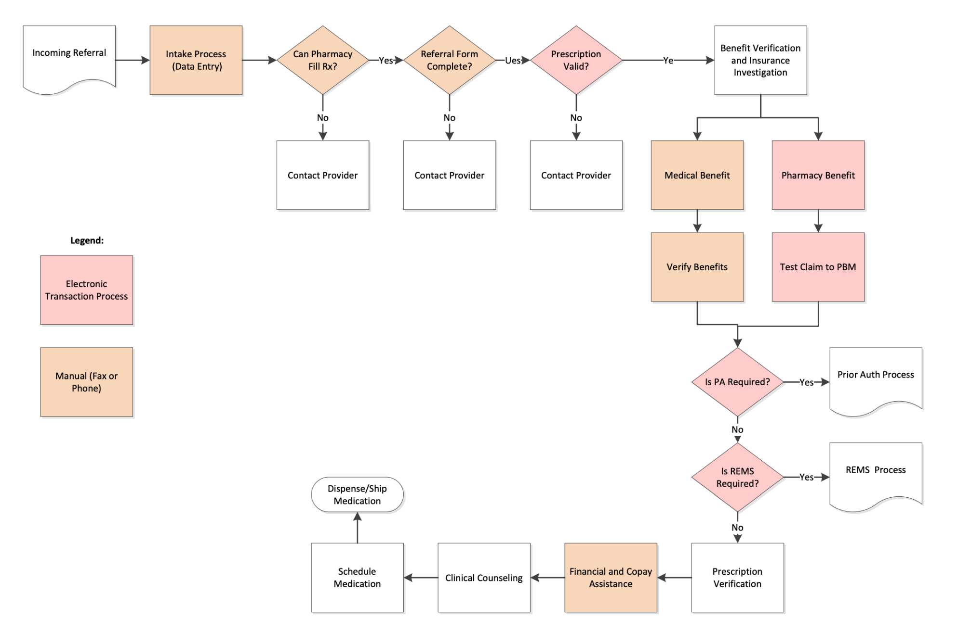
Specialty Process
https://ncpdp.org/Specialty-Pharmacy

Slide 16
Specialty Processes and Steps
Electronic
  ePrescribing
  ePrior Authorization
  REMS
  Benefit verification (pharmacy)
  RTPB
  Reporting
Manual
  Intake process
  Referral form
  Patient consent
  Benefit verification (medical)
  Financial and copay assistance

Slide 17
Specialty Challenges
No universal definition of specialty
No universal reimbursement, dispensing or administration model
Limited Distribution Drugs (LDDs)
Multiple stakeholders involvement
Information exchange differences

Slide 18

Goals for Enhancement
Focus on the patient journey
Improve transparency
Create automation
Work together with multiple stakeholders

Slide 19
Transactions to Enhance the Specialty Process

Slide 20
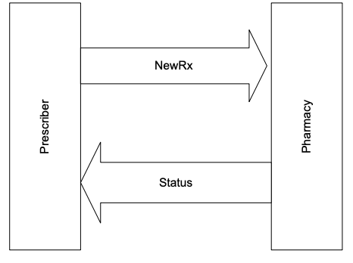
SCRIPT Standard
New SCRIPT Version (V2017071)
  Went into effect January 1, 2020
  New elements added
    Agency and service information
    IV administration
    Patient information (i.e. hospice status, alternate contact)
    Compounds
  Previous elements impacting specialty prescriptions
    Diagnosis
    Height/Weight
    Insurance Information

Slide 21
ePrior Authorization (ePA)
NCPDP SCRIPT Standard
  Supports prospective and retrospective models
  Allows for cancel and appeal functions
  Supports pharmacist-initiated requests
  H.R. 6
  Electronic prior authorization for covered Part D medications
  Requires the Secretary of HHS to establish a standard, secure electronic prior authorization system no later than January 1, 2021 (delay due to COVID)
  Fax, proprietary payer portals that do not meet standards defined by the Secretary, and electronic forms will not be treated as an electronic submission for the purpose of electronic prior authorization

Slide 22
Risk Evaluation and Mitigation Strategy (REMS)
  REMS transactions
  Provide a fully electronic means for determining whether a REMS authorization is required for a particular product and patient and any details of any requirements
  Provide REMS information to the prescriber system in a consistent format while enabling each REMS Administrator to request the specific information it requires
  Allow the prescriber to transmit information to the REMS Administrator to verify that REMS safe use conditions have been met
  Provide an approval or denial with associated messages

Slide 23
Real-Time Prescription Benefit (RTPB)
  NCPDP RTPB Standard is available
    Published beta version in January 2020
    Working on new version with 2021 publication
    XML and EDI formats, the primary syntaxes used in the pharmacy/healthcare industry
    RTPB can be submitted by prescriber or pharmacy
  Provides the following
    Patient eligibility
    Product coverage
    Benefit financials for a chosen product and pharmacy
    Coverage restrictions
    Alternative products
    Benefit alternatives

Slide 24
Reporting
  Reporting standard between pharmacy and manufacturer
    Dispense data reporting standard published in January 2018
    Other categories the group has considered
      Inventory
      Performance metrics
      Outcomes
  What’s next
    Waiting for X12 approval of inventory implementation guide
    Identifying additional use cases and identifying next steps
    Coordinating with other entities for performance metrics to ensure alignment
    Looking at pilot opportunities utilizing the dispense data reporting standard

Slide 25
Benefit Coverage Identification White Paper

Slide 26
Specialty Pharmacy Benefit Coverage Identification White Paper
Task Group created in August 2018
  Research challenges with identifying coverage for specialty pharmacy products
  Identify available technical solutions
  Delineate gaps
  Offer recommendations

Slide 27

White Paper Outline
Current Challenges
Current Methodology
BI Considerations
Expected roles and responsibilities
Complexities in determining coverage
Critical Success Factors
Timeline/Implementation
  https://ncpdp.org/White-Papers.aspx

Slide 28
White Paper Purpose
“The purpose of this white paper is to highlight current challenges experienced by providers, dispensers and organizations in being able to timely and accurately identify the appropriate benefit coverage (medical or pharmacy benefit) for a specific medication being prescribed, as well as potential out of pocket costs to the patient, at the time of care. Overall, the desired outcome of benefit identification is to provide a comprehensive benefit coverage overview electronically at the time the medication is selected and to improve a patient’s ability to begin therapy without delay. This process should be easily accessible without multiple manual steps or duplication of efforts by providers, specialty pharmacies and hubs. “

Slide 29
Reality of Benefit Identification Inquiry
Specialty Medications can be covered as medical, pharmacy or under both benefits.
Duplicative efforts happen due to the opaque nature of the current process and with the provider’s desire to increase speed to treatment.
Given the multiple pathways, complexity and variability for benefit investigation today, duplication is inherent to the current system and drives inefficiencies impacting prescribers and patients alike. The focus should be on increasing automation.

Slide 30
Available Standards to Support Benefit Investigation
Standards Organization | Standard name | Standard used for
NCPDP | SCRIPT Standard | Electronic Prior Authorization
NCPDP | Telecommunication Standard | Benefits and Eligibility Investigation (E1 Eligibility Transaction)
NCPDP | Real Time Prescription Benefit Standard | Pharmacy Benefits Inquiry and Response
X12 | 278 Transaction | Health Care Services Review Information
X12 | 270/271 Transaction | Health Care Eligibility Benefit Inquiry and Response
HL7 | Fast Healthcare Interoperability Resources (FHIR®) | Application Programming Interface (API) for exchanging health records information

Slide 31
White Paper Next Steps
Sharing with appropriate audiences
Revisions to support non-specialty settings
Leverage existing functionality to improve data exchange
Identify standards development/enhancement opportunities

Slide 32
Collaboration Amongst Standard Organizations

Slide 33
Collaboration with other Standards Development Organizations (SDOs)
Health Level 7 (HL7)
  Use of FHIR standard to support specialty pharmacy enrollment
  Exploring use of FHIR to enable exchange of patient consent data
X12
  Worked with X12 to develop guidance for inventory reporting
  Approved by NCPDP membership; awaiting approval by X12 membership

Slide 34
HL7
Founded in 1987, Health Level Seven International (HL7) is a not-for-profit, ANSI-accredited standards developing organization dedicated to providing a comprehensive framework and related standards for the exchange, integration, sharing and retrieval of electronic health information that supports clinical practice and the management, delivery and evaluation of health services.

Slide 35
HL7 Standards
FHIR is an interoperability standard intended to facilitate the exchange of healthcare information between healthcare providers, patients, caregivers, payers, researchers, and any one else involved in the healthcare ecosystem. It consists of 2 main parts – a content model in the form of ‘resources’, and a specification for the exchange of these resources in the form of real-time RESTful interfaces as well as messaging and Documents.
The HL7 Version 3 Clinical Document Architecture (CDA®) is a document markup standard that specifies the structure and semantics of "clinical documents" for the purpose of exchange between healthcare providers and patients. It defines a clinical document as having the following six characteristics: 1) Persistence, 2) Stewardship, 3) Potential for authentication, 4) Context, 5) Wholeness and 6) Human readability.
A CDA can contain any type of clinical content -- typical CDA documents would be a Discharge Summary, Imaging Report, Admission & Physical, Pathology Report and more. The most popular use is for inter-enterprise information exchange, such as is envisioned for a US Health Information Exchange (HIE).

Slide 36
X12
X12, chartered by the American National Standards Institute for more than 40 years, develops and maintains EDI standards and XML schemas which drive business processes globally. X12's diverse membership includes technologists and business process experts in health care, insurance, transportation, finance, government, supply chain and other industries.

Slide 37
X12 Subcommittees
X12C – Communications and Controls
X12F – Finance
X12I – Transportation
X12J – Technical Assessment
X12M – Supply Chain
X12N – Insurance

Slide 38
X12N - Insurance
Responsible for development and maintenance of HIPAA-named transactions
  Health Care Eligibility/Benefit Inquiry and Information Response (270/271)
  Health Care Claim: Professional, Institutional, and Dental (837)
  Health Care Payment/Advice (835)
  Health Care Services Review Information (278)

Slide 39
Where else is NCPDP involved?
PBMI
AMCP
CMS
IAIBC
PQA
ASCP
FDA
NASP
Safe Bio Pharma
ASHP
HIMSS
NCPA
WEDI
CAQH CORE
HL7
ONC
X12

Slide 40
Specialty Work Group
Overview and Involvement

Slide 41
NCPDP Specialty Work Group Overview
Goals
  Identify pain points and delays
  Develop new transactions and messages
  Develop guidance for use of existing standards and transactions
  Monitor state and Federal activities and legislation related to Specialty medications
  Collaborate with other Standards development organizations
  Collaborate with other NCPDP Work Groups and Task Groups
  Increase participation
Partnering
  HL7
  X12
  PQA
Identify the gaps
Develop and implement
NCPDP Specialty Work Group: WG 18
Current technology available

Slide 42
Specialty ePrescribing TG
Specialty Pharmacy Data Exchange
Benefit Coverage Identification
Patient Consent
Facilitating Access to Specialty Products
Identify additional information needed for Specialty ePrescribing and identify electronic channels to obtain the information
Other TG of Interest
Expanded Dollar Field (WG1)
Prior Authorization Workflow to Transactions (WG11)
REMS Workflow to Transactions (WG11)
Identification of Social Determinants of Health (WG 10)
Standardize documentation, reporting or data exchange to support agreements
Impacts:
Pharmacies
Manufacturers
PBMs
Hubs
Data aggregators
Payers
Impacts:
Prescribers
Pharmacies
Prescribing intermediaries
Addresses areas of opportunity related to determining if coverage is through the medical or pharmacy benefit
Impacts:
Prescribers
Pharmacies
Payers
PBMs
Improve communication and access to information around specialty and/or limited distribution products
Impacts:
Prescribers
Pharmacies
Hubs
Electronic exchange of patient consent information for the purpose of transmitting in the DME and Pharmacy related transactions
Impacts:
Prescribers
Pharmacies
Hubs
Hubs
Manufacturers
Manufacturers
Digital Therapeutics (MC)
Task Groups Under WG 18

Slide 43
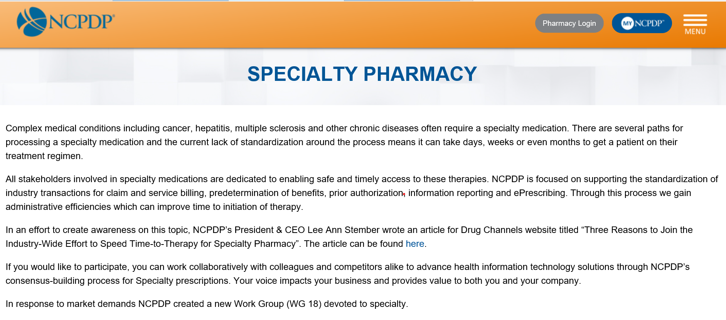
NCPDP Specialty Resources
NCPDP Specialty Pharmacy Resources:
  https://ncpdp.org/Specialty-Pharmacy
Contains:
  Overview of Work Group 18
  More information on Task Groups
  How to join the Collaborative Workspace
  Help Shape the Future of Specialty Pharmacy
    https://ncpdp.org/NCPDP/media/pdf/NCPDPSpecialtyPharmacyFlyer.pdf
  Previous webinars and Specialty related videos
  Specialty Pharmacy Benefit Coverage Identification White paper

Slide 44

Join a task group
  Does not require membership
  Meet on a routine basis via conference calls
  Meetings occur between quarterly Work Group meetings
  Sign up: Go to the NCPDP Collaborative Workspace at http://dms.ncpdp.org/
Upcoming Events
  February Work Group Meeting: February 3-5, 2021
  NCPDP Events Calendar: https://www.ncpdp.org/Events-Calendar.aspx
  May 2021 Joint Technical Work Group Meetings (Virtual): May 3-5, 2021

Slide 45
Post-Test Question 1
Which NCPDP transactions can be utilized to automate the specialty process?
ePA
ePrescribing
RTPB
REMS
All the above

Slide 46
Post-Test Question 1
Which NCPDP transactions can be utilized to automate the specialty process?
ePA
ePrescribing
RTPB
REMS
All the above

Slide 47
Post-Test Question 2
What data is not included in the RTPB?
Patient eligibility
Product coverage
Limited distribution drug status
Benefit financials for a chosen product and pharmacy

Slide 48
Post-Test Question 2
What data is not included in the RTPB?
Patient eligibility
Product coverage
Limited distribution drug status
Benefit financials for a chosen product and pharmacy

Slide 49
Post-Test Question 3
Which organizations does NCPDP collaborate with to improve patient care?
X12
CMS
HL7
PQA
All the above

Slide 50
Post-Test Question 3
Which organizations does NCPDP collaborate with to improve patient care?
X12
CMS
HL7
PQA
All the above

Slide 51
Post-Test Question 4
Which standards organization created the 270/271 transaction designed to help with benefit coverage?
NCPDP
HL7
CAQH
X12

Slide 52
Post-Test Question 4
Which standards organization created the 270/271 transaction designed to help with benefit coverage?
NCPDP
HL7
CAQH
X12

Slide 53
Post-Test Question 5
Which of the following processes needs an electronic solution for a specialty patient?
Medication prescribing
Patient consent
REMS
Prior authorization

Slide 54
Post-Test Question 5
Which of the following processes needs an electronic solution for a specialty patient?
Medication prescribing
Patient consent
REMS
Prior authorization

Slide 55
Questions?

Slide 56
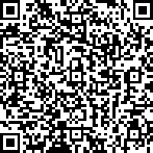
Claim CE Weblink
1. Access the QReader to be taken to Registration Page enter the platform, complete the evaluation and claim CE credit. OR Type this address into the browse of any device – https://www.lecturepanda.com/r/NCPDPEvolve2
2. Be prepared to have your CPE Monitor number to enter along with your Birth Month and Birth Date. If the information you input does not match CPE Monitor, you will immediately be informed to correct.
3. Complete the QUIZ – your credit should post with CPE Monitor in about 24 hours.

Slide 57
Evaluation Weblink
https://www.lecturepanda.com/r/NCPDPEvolve2
Please use the weblink shown above to access the online evaluation. Enter this address into the browser of your phone, tablet, laptop or desktop. The process should take less than 5 minutes.
This evaluation asks for your CPE Monitor number in order to post CE credit, so have that number ready when you start the evaluation.
Your credit will post about 4 weeks from the date of this event.
If you have questions, please email: office@instituteforwellness.org

Slide 58

Concepts
We’re prioritizing
health and safety.
The HIMSS Global Conference & Exhibition
will be held August 9-13, 2021
himssconference.org

Slide 59
SAVE THE DATE:
NCPDP Annual Technology & Business Conference
June 29-30, 2021
Westin Kierland Resort & Spa
Scottsdale, Arizona

Slide 60

NCPDP Collaborative Workspace
The Work Groups meet quarterly face to face to discuss issues critical to pharmacy standards. Between quarterly work group meetings, the NCPDP Task Groups meet. Task group call schedules, working papers, and detailed information on each task group can be found here. NCPDP Task Groups are open to any materially interested party (NCPDP member or not) that wishes to participate and help provide standards, guidance, and problem solve.
To participate in NCPDP Task Groups, please visit the Collaborative Workspace and help improve the pharmacy industry!

Slide 61

Thank you.
Contact Tammy Kwiatkoski tkwiatkoski@himss.org
312-915-9516

