Slide 1
Beyond the Pandemic
Telehealth, Virtual Care and the Road Ahead
June 29, 2021
Notes:
GWYNNE:

Slide 2





Vision
Mission
To realize the full health
potential of every human, everywhere.
Reform the global health ecosystem through the power of information and technology.
Notes:
GWYNNE

Slide 3
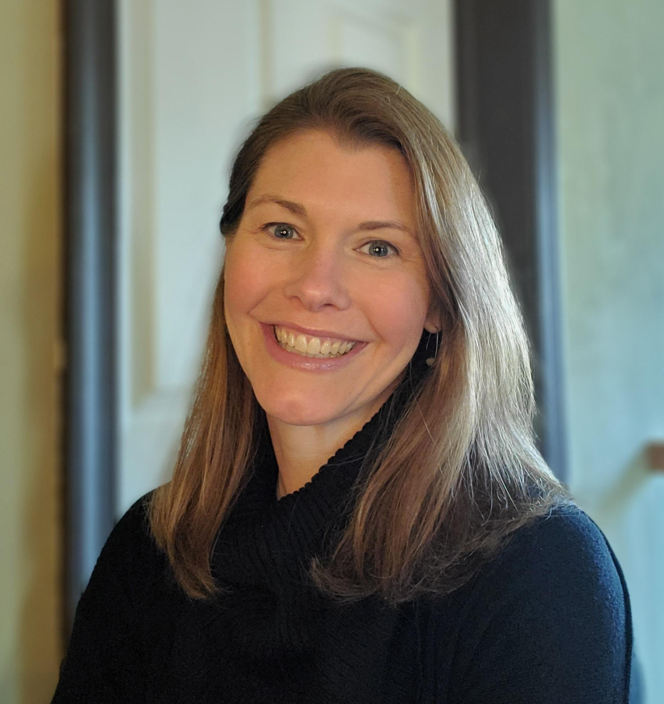
Welcome
Gwynne Jelbaoui
Program Manager
Clinical Informatics HIMSS
Gwynne.Jelbaoui@himss.org
Notes:
GWYNNE

Slide 4








Education
Community
Present webinars on telehealth, medical informatics, clinical decision support and best use of EHR systems
Volunteer efforts include –CMIO Roundtable & Workgroups, Clinician Circle (ambassador)
Thought Leadership
CMIOs
Value of CMIO; CMIO Roundtable
Policy input, interviews with HIMSS Media; Pre-Con Symposium Planning
Physician Community
Education Task Force
Physician Resources
Drive education and content for Community
Career profiles, education, articles, blogs
www.himss.org/membership-participation/physician
Strategic Partners
AMDIS, PEHRC with CMSS, AHA, Heart Rhythm Society, AMA
Notes:
GWYNNE

Slide 5
Beyond the Pandemic: Telehealth, Virtual Care and the Road Ahead
Learning Objectives
Understand the short-term and long-term effects of the pandemic on telehealth adoption and use.
Evaluate the impact on providers and patients of telehealth workflow/process changes, including how these impacts varied across patient populations and care communities.
Assess how the healthcare industry's response to the pandemic can prepare organizations for future health crises.

Slide 6

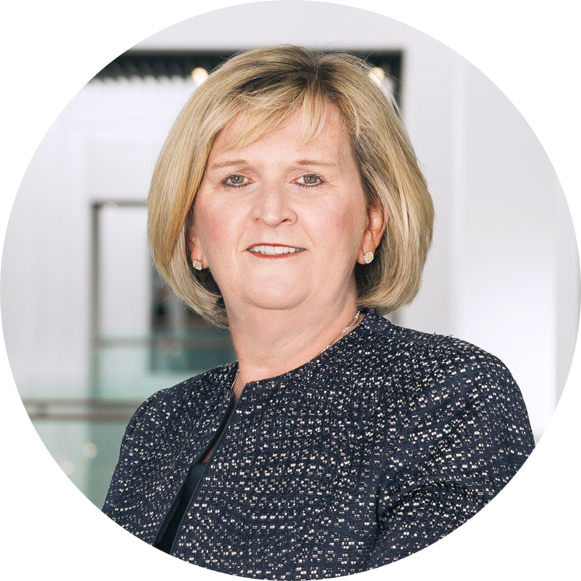
Welcome
Helen Waters
Executive Vice President
MEDITECH

Slide 7
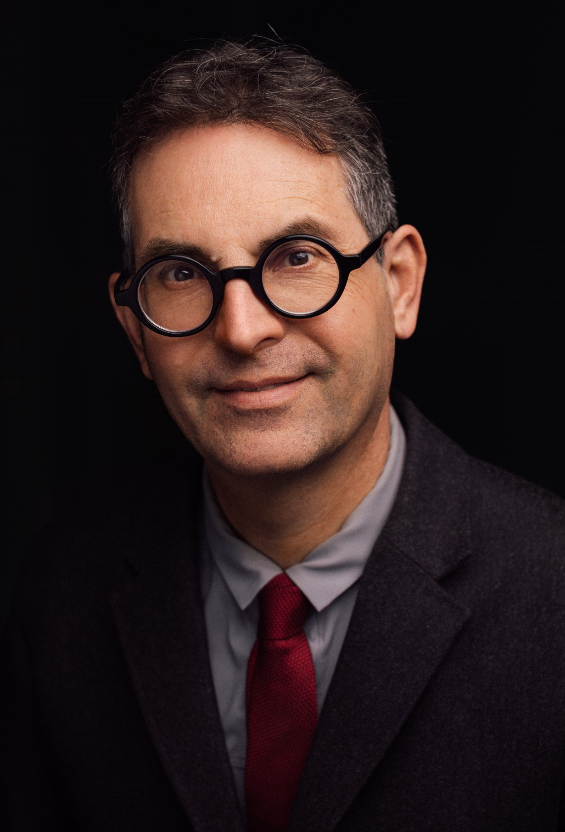
Dr. John Halamka
Dr. Halamka is an emergency medicine physician, medical informatics expert and president of the Mayo Clinic Platform, which is focused on transforming health care by leveraging artificial intelligence, connected health care devices and a network of partners.
Dr. Halamka has been developing and implementing health care information strategy and policy for more than 25 years.
Previously, he was executive director of the Health Technology Exploration Center for Beth Israel Lahey Health, chief information officer at Beth Israel Deaconess Medical Center, and International Healthcare Innovation Professor at Harvard Medical School. He is a member of the National Academy of Medicine.
Notes:
HALAMKA Intro self and why topic important to him etc

Slide 8
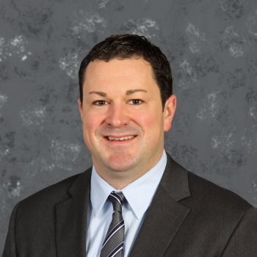
Dr. Andrew Burchett
Family Physician and
Chief Medical Information Officer
Avera Health
Chair of Family Medicine
Avera McKennan Hospital
Notes:
Dr. Burchett self intro and org overview

Slide 9


Dr. Andrew Burchett
Overview
About me
About Avera
About our telehealth strategy

Slide 10
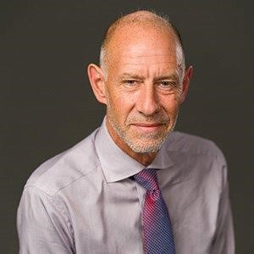
Dr. Philip Klassen
Vice President, Medical Affairs
Ontario Shores Centre for Mental Health Sciences
Assistant Professor
Departments of Psychiatry and Medicine, University of Toronto
Notes:
Dr. Klassen self intro and org overview

Slide 11


Dr. Philip Klassen
Overview
About me
About Ontario Shores
About our telehealth strategy

Slide 12
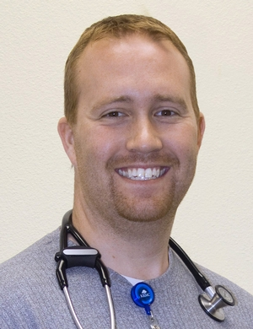
Dr. John Tollerson
Chief Medial Information Officer & Interim CMO of Ambulatory Clinics
Logan Health
Notes:
Dr. Tollerson self intro and org overview

Slide 13
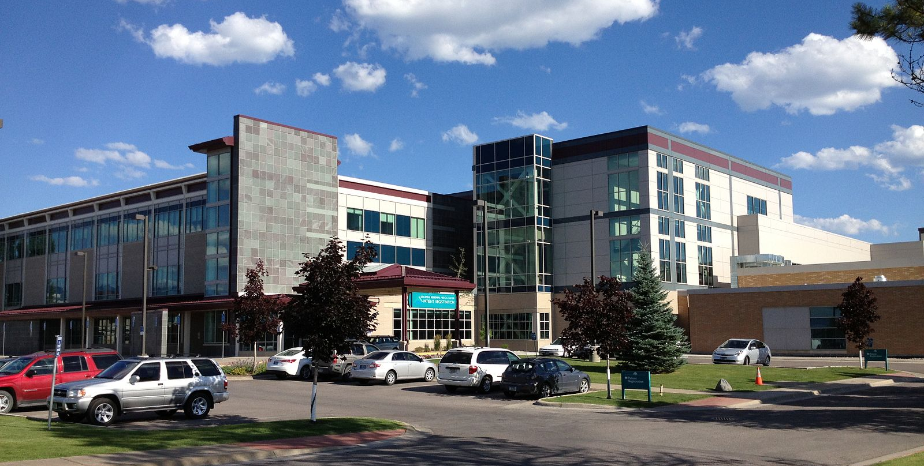

Dr. John Tollerson
Overview
About me
About Logan Health
About our telehealth strategy

Slide 14


Questions?

Slide 15
Thank you
Dr. John Halamka
Dr. Andrew Burchett
Dr. Philip Klassen
Dr. John Tollerson
Notes:
GWYNNE

Slide 16

Thank you to our sponsor
Notes:
GWYNNE

Slide 17

Thank you!
Contact emails:
Physician Community informatics@himss.org
Gwynne Jelbaoui
Gwynne.Jelbaoui@himss.org
Notes:
GWYNNE

