Slide 1

Harmonization of Dosing Designations for
Oral Liquid Medications Across
Acute & Ambulatory Care Settings
Pharmacy Informatics Town Hall
August 4, 2022

Slide 2

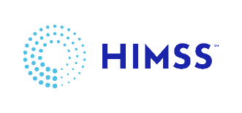

As a mission-driven non-profit, HIMSS offers a unique depth and breadth of expertise in health innovation, public policy, workforce development, research and analytics to advise global leaders, stakeholders and influencers on best practices in health information and technology.
HIMSS is a global advisor and thought leader supporting the transformation of the health ecosystem through information and technology.
With more than 350 employees, HIMSS has operations in:
North America | Asia Pacific | Europe | Latin America | Middle East | United Kingdom

Slide 3

About NCPDP
Founded in 1977, NCPDP is a not-for-profit, ANSI-accredited, Standards Development Organization with over 1,500 members representing virtually every sector of the pharmacy services industry.
NCPDP members have created standards such as the Telecommunication Standard and Batch Standard, the SCRIPT Standard for e-Prescribing, the Manufacturers Rebate Standard and more to improve communication within the pharmacy industry.
Our data products include dataQ®, a robust database of information on more than 80,000 pharmacies, HCIdea®, a database of continually updated information on more than 2.5 million prescribers, and resQ™, an industry pharmacy credentialing resource. NCPDP's RxReconn® is a legislative tracking product for real-time monitoring of pharmacy-related state and national legislative and regulatory activity.
www.ncpdp.org
3

Slide 4
Disclosures
Jennifer Lind, H. Shonna Yin and Gerald McEvoy have no relevant financial relationships to disclose.
4

Slide 5
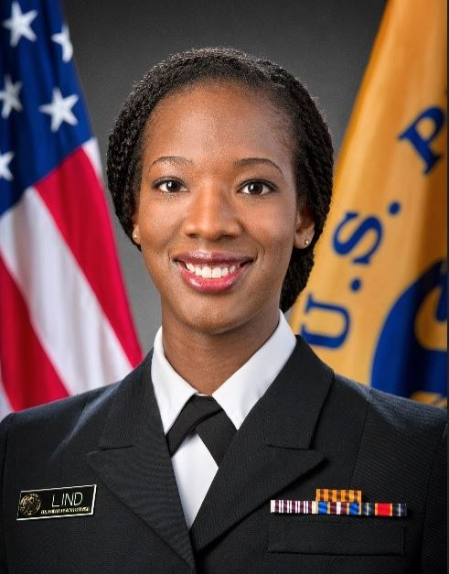


Jennifer N. Lind, PharmD, MPH, MBA
Partnerships & Prevention Lead in CDC’s Medication Safety Program and a Commander in the United States Public Health Service Commissioned Corps
CDR Lind received her Doctor of Pharmacy degree from Florida A&M University in 2007, Master of Public Health from Georgia State University in 2012, and Master of Business Administration from Emory University in May 2022. After receiving her MPH, she completed a two-year fellowship as an Epidemic Intelligence Service (EIS) officer.
Following EIS, she worked in CDC’s Birth Defects Branch and eventually became the Lead Scientist for CDC’s Treating for Two initiative, focused on safer medication use in pregnancy. CDR Lind’s current work in CDC’s Medication Safety Program focuses on reducing harms from the use of medications and she serves as Lead Pharmacist for the PROTECT initiative, an innovative public-private partnership that uses a collaborative, data-driven approach to reduce harms from unintentional medication overdoses in children.

Slide 6
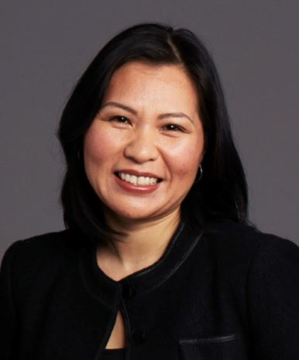

H. Shonna Yin, MD, MSc
General academic pediatrician and an Assoc Prof. of Pediatrics and Pop Health at the NYU Grossman School of Medicine
Dr. Yin is a federally funded researcher who has spent 15+ years examining issues at the intersection between health literacy and medication safety. Dr. Yin’s NIH/NICHD-funded research supported the identification of best practices in the labeling/dosing of pediatric Rx medication labels and dosing tools, informing clinical practice and policy change, including AAP Policy Statements and guidance's from the USP and NCPDP.
Dr. Yin has been a key member of the CDC’s PrOTECT initiative to reduce medication overdoses in children since it was formed in 2008. She received the 2017 Institute for Safe Medication Practices Cheers Award in recognition for her outstanding research on strategies to prevent parent medication administration errors. Dr. Yin is a graduate of MIT and the University of Rochester School of Medicine. She completed residency training in Pediatrics and a Masters of Science degree in Clinical Investigation at the NYU Grossman School of Medicine.

Slide 7
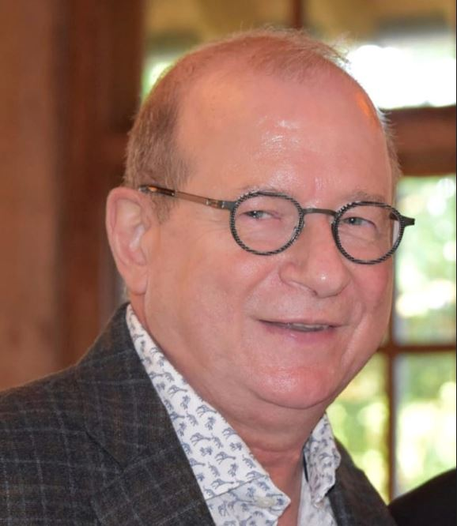
Gerald McEvoy, PharmD
Consultant
Dr. McEvoy is a Consultant on Drug Policy, Safe and Effective Medication Use, and Standards on Drug Prescribing, Electronic Data, and Pharmacy Practice. For 38 years, he led the publication of 6 clinical drug databases as AVP Drug Information and Editor in Chief at ASHP. Dr. McEvoy continues to serve as Co-lead of NCPDP’s mL White Paper and Universal Medication Schedule White Paper Task Groups, and its Naming Standards for Drugs, Biologics, and Biosimilars Task Group. Through his leadership at NCPDP, CDC’s PROTECT Initiative, and USP, he has been instrumental in advancing national best practices aimed at US adoption of mL as the universal unit of measure for patients to measure liquid oral medications and of other standards for prescription container labels.

Slide 8
Outline
Dr. Lind will provide background on:
  Epidemiology of emergency department visits for pediatric medication overdoses
  Rationale for NCPDP’s 2014 “NCPDP Recommendations and Guidance for Standardizing the Dosing Designations on Prescription Container Labels of Oral Liquid Medications”
Dr. Yin will summarize:
  Research findings supporting potential error reduction and improved outcomes with metric-only dosing, standardized dosing tools, and health-literacy informed communication
  American Academy of Pediatrics recommendations for preventing medication administration errors
Dr. McEvoy will summarize the Updated 2021 NCPDP Recommendations
  Rationale for NCPDP’s 2021 update “NCPDP Recommendations for Standardizing Dosing in Metric Units (mL) on Prescription Container Labels for Oral Liquid Medications”
  Areas of revision focus
  Key updated recommendations for universal adoption
8

Slide 9

Jennifer N. Lind, PharmD, MPH, MBA

Slide 10
Learning Objectives
At the end of this presentation, pharmacists and pharmacy technicians will be able to:
Describe the safety rationale for using milliliter (mL) as the standard unit of measure used on prescription container labels for oral liquid medications.
Describe the safety rationale for why dose amounts should always use leading zeros before the decimal point for amounts less than one on prescription container labels for oral liquid medications.
Describe the safety rationale for why dose amounts should not use trailing zeros after a decimal point on prescription container labels for oral liquid medications.
Explain why dosing devices with numeric graduations and units that correspond to the container labeling should be made easily and universally available.
Explain why dosing devices should be of appropriate volume and accuracy for the amount prescribed.
10

Slide 11

Disclaimer
The findings and professional conclusions in this presentation are those of the author(s) and do not necessarily represent specific views of the Centers for Disease Control and Prevention (CDC).
11

Slide 12
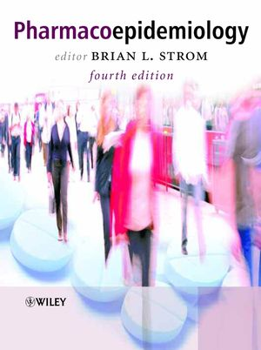
Why is CDC Involved in Labeling Standards?
Filling a Gap in Adverse Drug Event (ADE) Data?
“Currently, attention focuses on whether to approve (or withdraw) new drugs.”
“No organization primarily focuses on monitoring [adverse] effects of older drugs.”
Strom BL, JAMA, 2004:2642-6
12

Slide 13
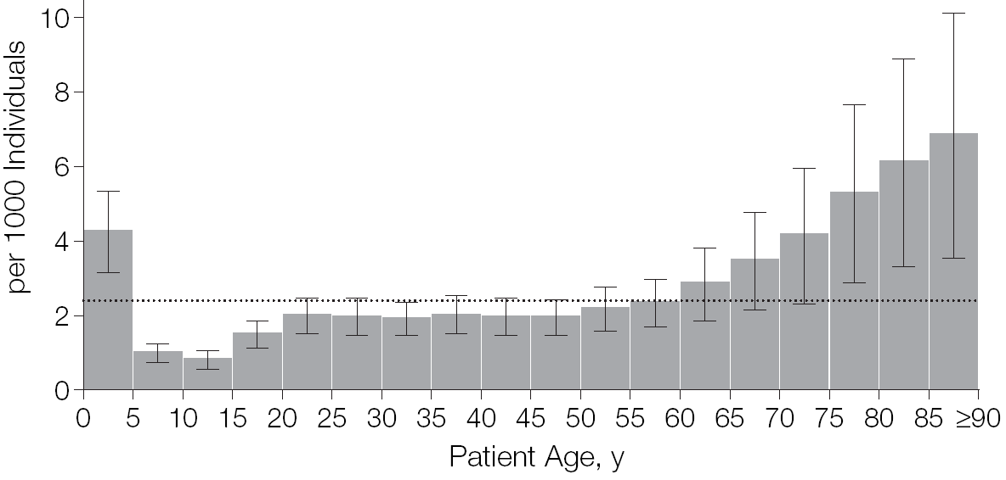
ED Visits for ADEs Relatively Common in Children <5
Most Involve Overdoses/Unintentional Exposures
Approximately 0.5% annual incidence
  1 ED visit per 200 children <5 per year
Unintentional Exposures / Overdoses
60%
60%
Cohen AL, et al. J Pediatr 2008;152:416-421
Schillie SF, et al. Am J Prev Med 2009;37:181-7
Budnitz DS et al. JAMA 2006;296:1858-66
13

Slide 14
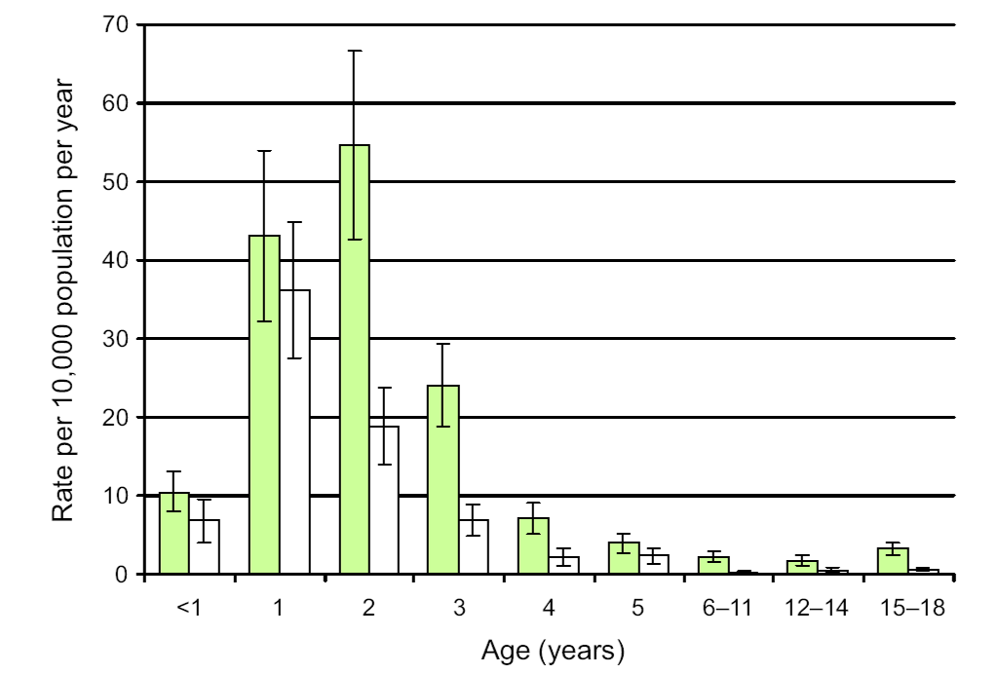
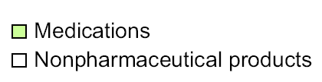
More children are brought to Emergency Departments (EDs) for unintentional medication exposures and overdoses than exposures to all other consumer products combined
2004-2005
Schillie SF, et al. Am J Prev Med 2009;37:181-7
14

Slide 15
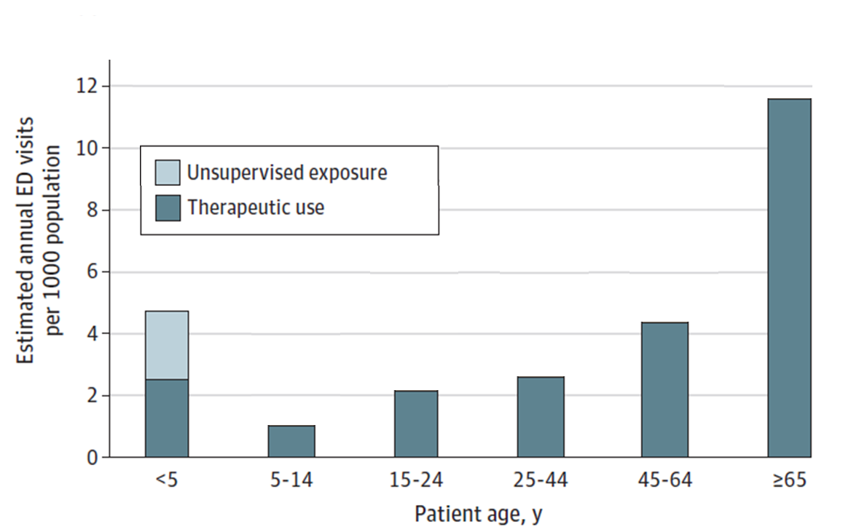
Children <5 years come to EDs for medication-related harms at a higher rate than all others under 65 years old*
*Excludes self-harm and abuse, 2017-2019
Budnitz DS et al. JAMA 2021;326:1299-1309
15

Slide 16
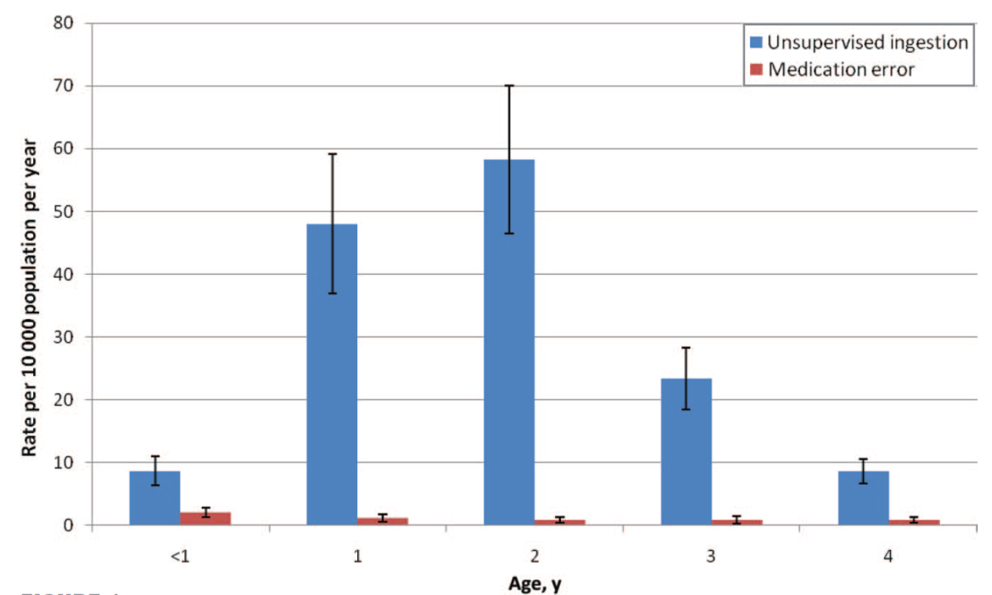
ED Visits for ADEs Relatively Common in Children <5
Medication Errors Most Common Among Youngest Children
60%
Budnitz DS and Salis S. Pediatrics 2011;127:1597-9
Cohen AL, et al. J Pediatr 2008;152: 416-421
Schillie SF, et al. Am J Prev Med 2009;37:181-7
16

Slide 17
If Serious Medication Errors are Relatively Rare, Why Care?
“First, Do No Harm”
Dosing mistakes involving units and amounts were frequent errors in ED visits
Nonstandard units (mg, dram, dropperful, fl oz) |  |  | Variable Errors
1.0 | vs | 1 | 10-fold
1 / 2 | vs. | ½ | 4-fold
TBSP | vs. | tsp | 3-fold
mL | vs. | tsp | 5-fold
Parker et al. New Engl J Med 2009;36:1912-31
17

Slide 18
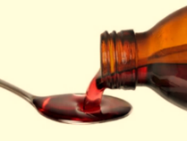

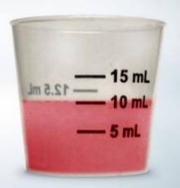
Administration mix-ups can lead to multi-fold medication overdoses (and underdosing errors)
Instruction | Mix-up | Outcome
Give 1 teaspoon | Gave 1 Tablespoon | 3-fold overdose
Give 1/2 teaspoon | Gave 2 teaspoons | 4-fold overdose
Give 1 milliliter (mL) | Gave 1 teaspoon | 5-fold overdose
Give .1 milliliter (mL) | Gave 1 mL | 10-fold overdose
Give 1.0 milliliter | Gave 10 mL | 10-fold overdose
X
18

Slide 19
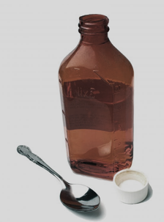
Oral Liquid Medication Dispensing in Retail Pharmacies: 1970s – 2000s
No commonly accepted dosing standards for labels
Household spoons most common dosing device
19

Slide 20
ED Visits for Unintentional Exposures/Overdoses Involving Medications were Rising in 2000s
ED Visits in Thousands
60%
Approximately 1 in 54 children born in 2008 were treated in an ED for a medication overdose by age 5
Medication Exposures
National Electronic Injury Surveillance System-Cooperative Adverse Drug Event Surveillance Project (NEISS-CADES)
20

Slide 21
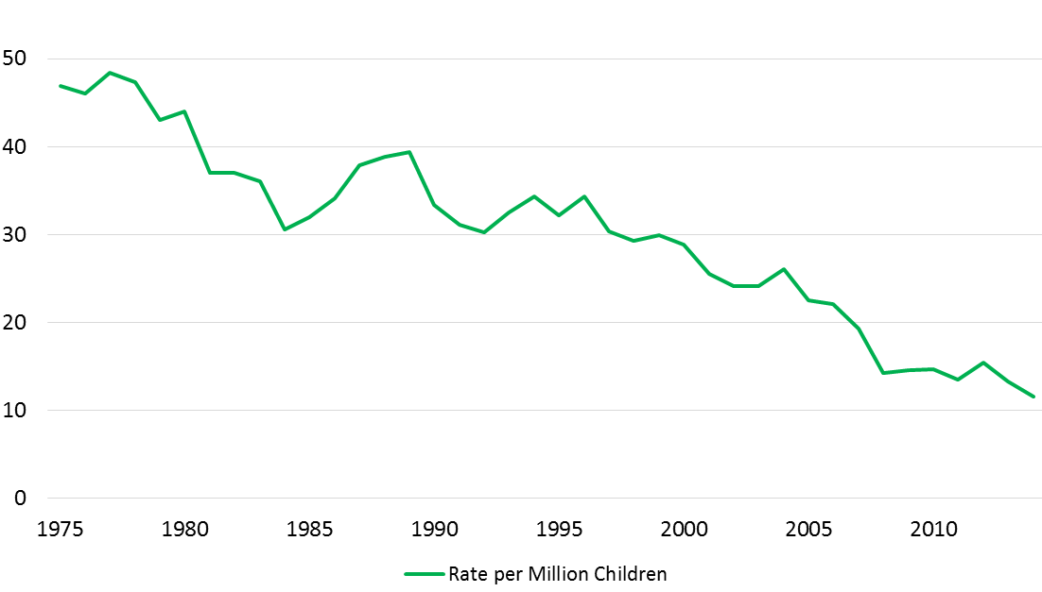
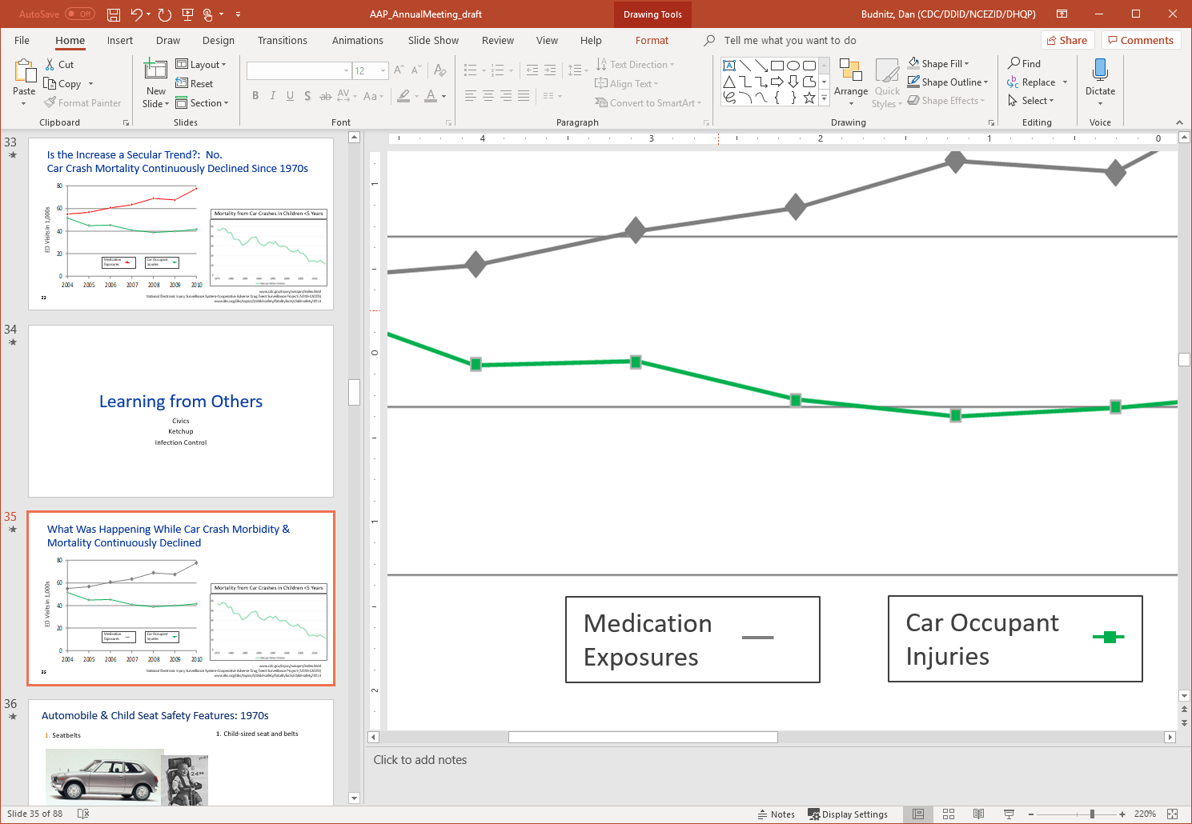
Car Crash Morbidity & Mortality: Continuously Declining Among Children <5
Mortality from Car Crashes in Children <5 Years
ED Visits in 1,000s
Medication Exposures
Car Occupant Injuries
www.iihs.org/iihs/topics/t/child-safety/fatalityfacts/child-safety/2014
www.cdc.gov/injury/wisqars/index.html
National Electronic Injury Surveillance System-Cooperative Adverse Drug Event Surveillance Project (NEISS-CADES)
21

Slide 22
Preventing Prescription Medication Overdoses
Limited Progress in Injury Prevention Measures over Several Decades
Safety Features, 1970s
Safety Features, 2010s
Child-resistant caps – 1970s
Child-resistant caps – 1970s
22

Slide 23
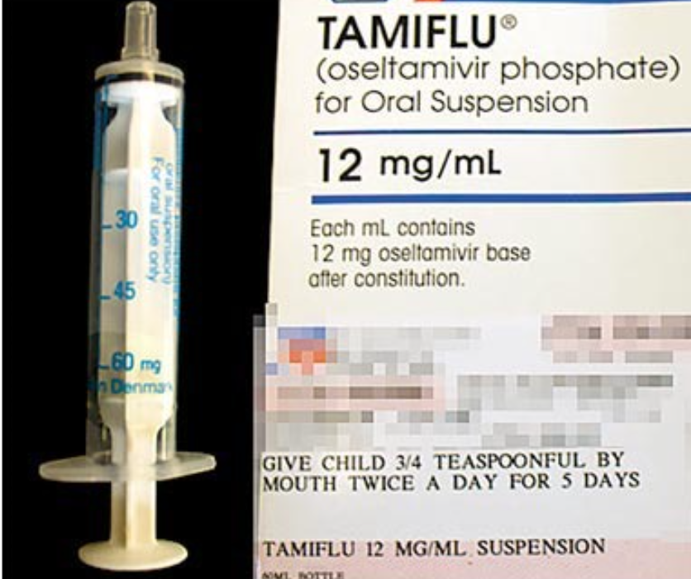
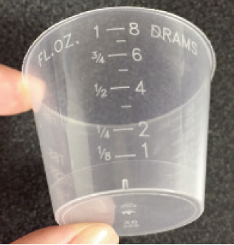
Addressing Dosing Errors was Catalyzed by Another Pandemic
“First, Do No Harm”
Dosing oseltamivir oral suspension demonstrates difficulty with nonstandard dosing units during 2009 H1N1 Outbreak
Mg, Dram, dropperful, FL Oz |  |  | Variable Errors
1.0 | vs | 1 | 10-fold
1 / 2 | vs. | ½ | 4-fold
TBSP | vs. | tsp | 3-fold
mL | vs. | tsp | 5-fold
Parker et al. New Engl J Med 2009;36:1912-31
23

Slide 24
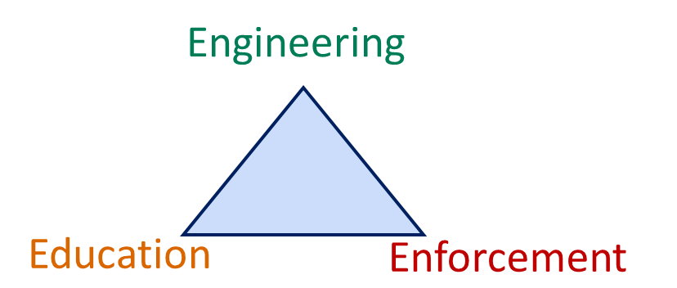
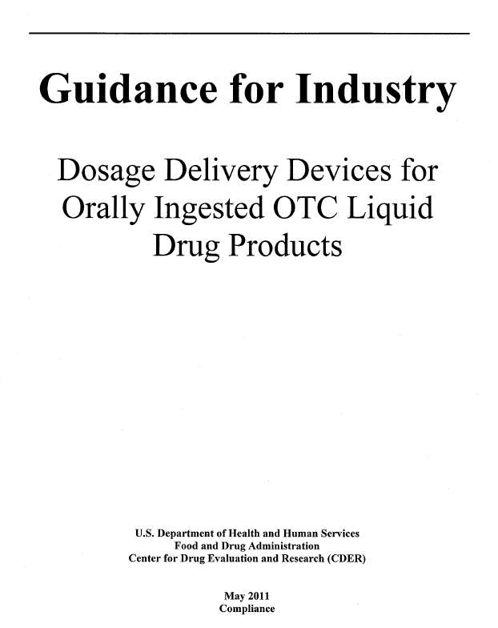
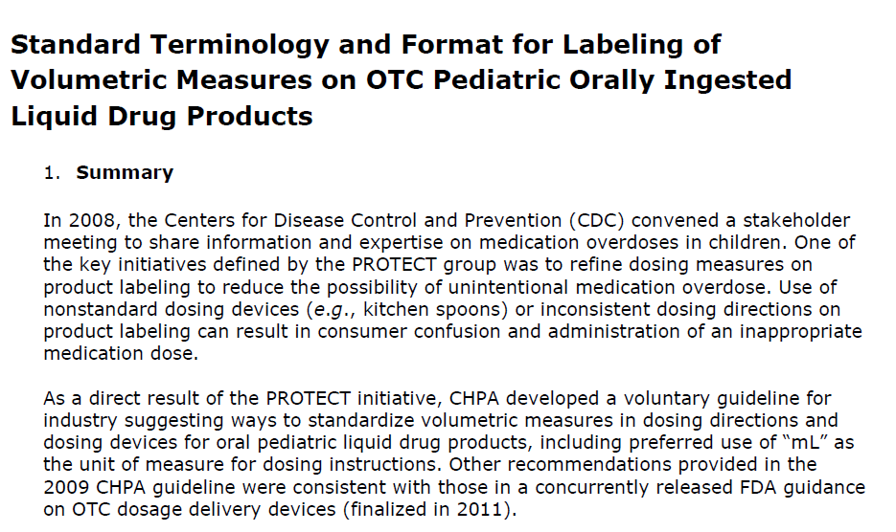

“Enforcement”: FDA and CHPA* Standards for
Over the Counter Products
Eliminate many nonstandard units and use of decimals
Align dosing directions and devices
Mg, Dram, dropperful, FL Oz |  |  | Variable Errors
1.0 | vs. | 1 | 10-fold
1 / 2 | vs. | ½ | 4-fold
TBSP | vs. | tsp | 3-fold
tsp | vs. | mL | 5-fold
*Consumer Healthcare Products Association (CHPA)
24

Slide 25
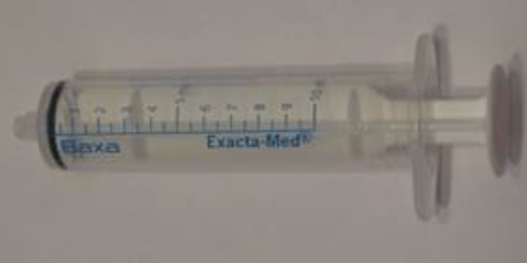
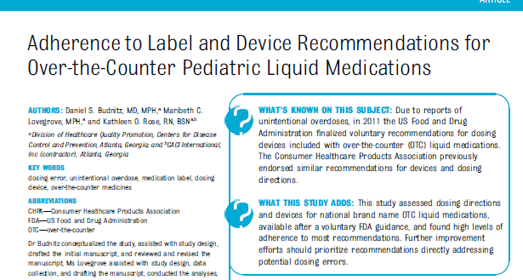
Standardization was Widely Implemented for OTC Pediatric Oral Liquid Medications
High adherence to voluntary standards among pediatric products
Oseltamivir dosing adjusted
Mg, Dram, dropperful, FL Oz |  |  | Variable Errors
1.0 | vs. | 1 | 10-fold
1 / 2 | vs. | ½ | 4-fold
TBSP | vs. | tsp | 3-fold
tsp | vs. | mL | 5-fold
Budnitz et. al. Pediatrics 2014; e283-90
25

Slide 26
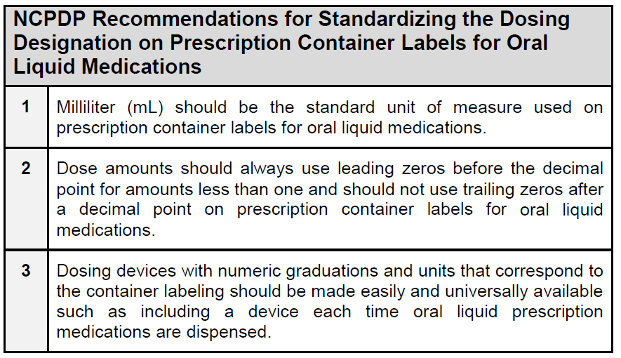
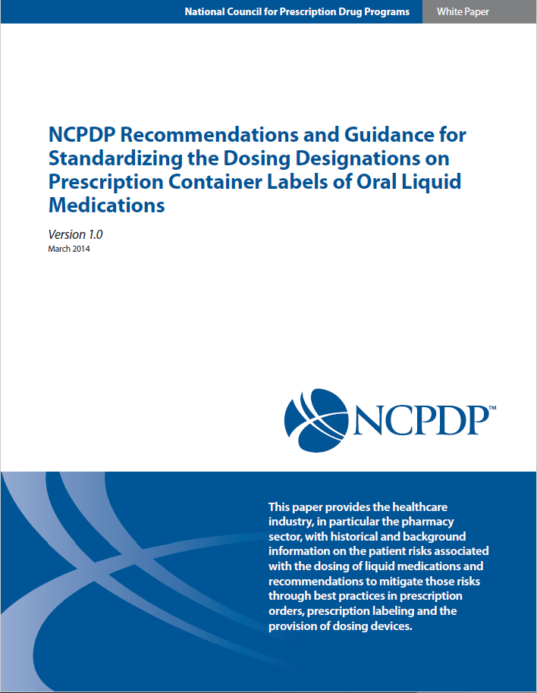
Introduction of Standards for Retail Pharmacy Oral
Liquid Dosing
NCPDP Recommendations Released in 2014
26

Slide 27
H. Shonna Yin, MD, MSc

Slide 28

Research Shows mL Reduces Measurement Errors
Labeling with TSP/teaspoon encourages use of kitchen spoons
  - When “TSP” on label, 3-fold higher odds parents choose kitchen spoon
  - When “teaspoon” on label, 5-fold higher odds parents choose kitchen spoon
TSP dosing instructions have 2-fold higher odds of dosing errors vs. mL
  - Parents who used teaspoon or tablespoon units had twice the odds of making
  a >=20% dosing error (45% vs 31%, P = .04; aOR=1.9 [1.03–3.5])
Low health literacy patients have greater accuracy with mL dosing
Spanish-speaking patients have greater accuracy with mL dosing
Yin et. al. Acad Pediatr. 2016;16:734-41
Yin et. al. Pediatrics 2014;134:e354–e361
28

Slide 29
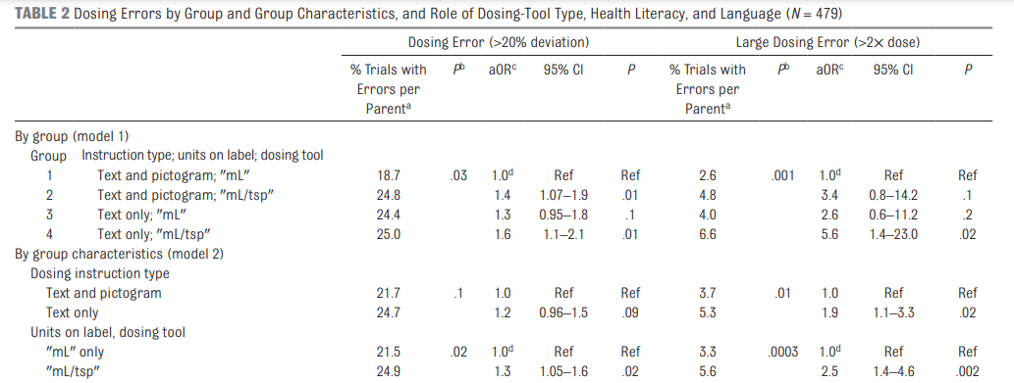
Data Support Transition from “mL/TSP” to “Only” mL
Pictograms, Units, and Dosing Tools and Parent Medication Errors,
HS Yin et al
Yin et. al. Pediatrics 2017;140:e20163237
29

Slide 30
Low Health Literacy & Medication Errors
Nearly 30% of US parents have low health literacy
  Only ~15% have “proficient” health literacy
Caregivers with low health literacy →
  greater difficulty understanding Rx and OTC labels
    increased odds of misunderstanding OTC labels (3.4x)
  Increased odds of using nonstandard kitchen spoons (2.4x)
  Increased odds of misunderstanding active ingredient info (>10x)
  Increased odds of being unaware of weight-based dosing (2.3x)
  Increased odds of making medication dosing error (1.5-2.5x)
Yin 2021, 2017, 2016, 2013, 2010, 2009, 2007; Harris 2017
30

Slide 31
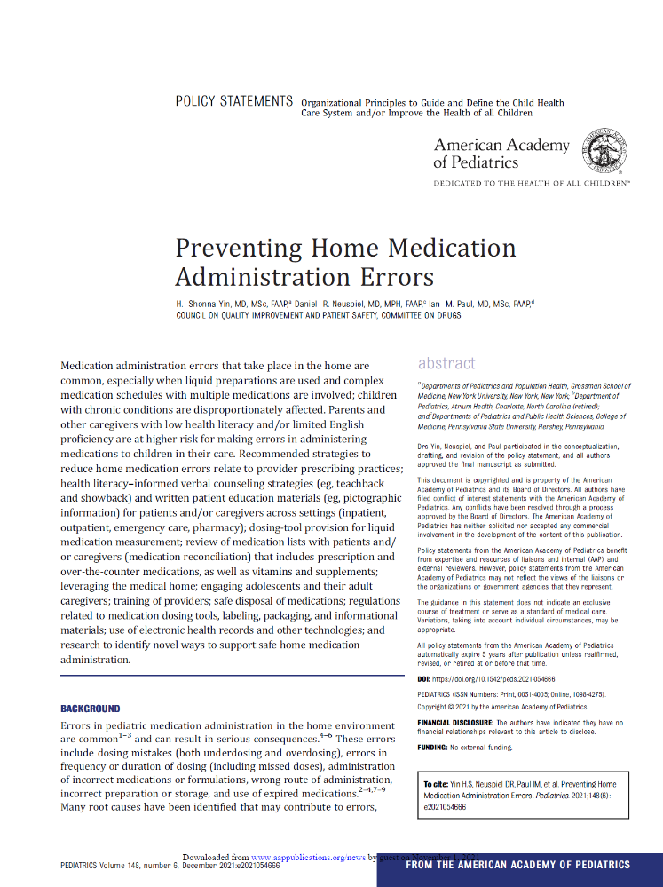
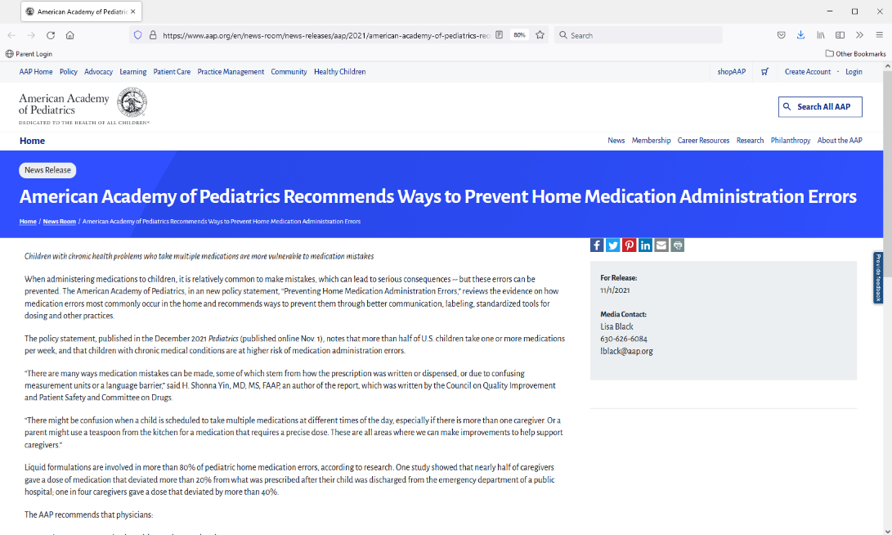

2021 AAP Policy Statement
https://publications.aap.org/pediatrics/article/148/6/e2021054666/183379/Preventing-Home-Medication-Administration-Errors
31

Slide 32

2021 AAP Policy Statement - Recommendation 1 (cont’d)
Promote use of appropriate dosing units
  - Use milliliter (mL) only units
  - Avoid spoon-based (e.g. teaspoon
  [tsp] or tablespoon [TBSP]) or non-
  metric units
Why?
  Multiple units used in dosing instructions (mL, tsp, TBSP)¹
    Risk of multi-fold errors²
      - mL vs. tsp→ 5x error
      - tsp vs. TBSP → 3x error
    More errors when Rx labels include teaspoon vs. mL-only³
      - 2.5x increased odds of large 2-fold dosing error
Shah R, et al. 2014; NCPDP, 2014; Yin HS, et al. 2017.
32

Slide 33
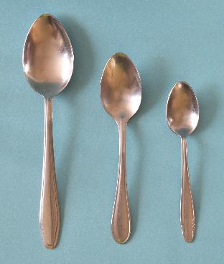
2021 AAP Policy Statement - Recommendation 1 (cont’d)
Promote use of appropriate dosing units
  - Use milliliter (mL) only units
  - Avoid spoon-based (e.g. teaspoon
  [tsp] or tablespoon [TBSP]) or non-
  metric units
Why? (cont’d)
  Spoon-based terms inadvertently endorse use of nonstandard tools¹
    Rx labels with spoon-based units vs. mL-only → >4x increased odds of preferring kitchen spoon
  Higher rate of dosing
  errors with
  kitchen spoons^{2,3}
    Kitchen spoons highly variable
Yin HS, et al. 2016; Madlon-Kay DJ, & Mosch FS. 2000; Wansink B, & Ittersum, K. 2010.
33

Slide 34
2021 AAP Policy Statement - Recommendation 1 (cont’d)
Provide dose amounts that are easy to measure
Why?
  Fraction and decimal amounts increase the likelihood of error¹
  Recs re: leading / trailing zeroes align with Joint Commission recs²
  Increased risk of 10-fold error^{3,4}
    When leading zeroes are left out
    When trailing zeroes are included
  Avoid fractions or decimal amounts when possible (use whole number amounts)
  Include leading zeroes (e.g. 0.X)
  Avoid trailing zeroes (e.g. X.0)
Yin HS, et al. 2010; Joint Commission, 2016; NCPDP, 2014; Paul I. 2015.
34

Slide 35
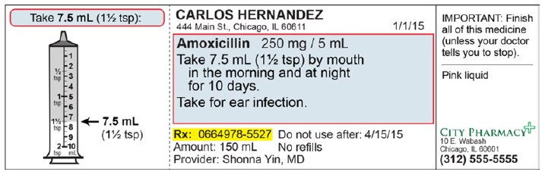
2021 AAP Policy Statement - Recommendation 1 (cont’d)
Learn and use health literacy (HL)-informed communication strategies
Why?
  Pictures/drawings^{1,2}
    Associated with a ~2-fold reduction in large (>2x) dosing errors
  Plain language
  Teachback / showback
  Pictures / drawings
Yin HS, et al. 2017; Yin HS, et al. 2011
35

Slide 36
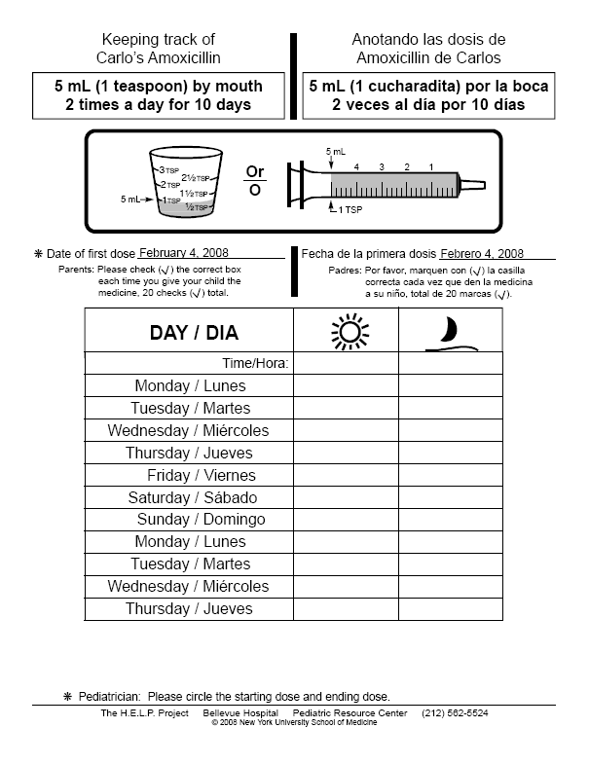
2021 AAP Policy Statement - Recommendation 1 (cont’d)
Learn and use health literacy (HL)-informed communication strategies
Why? (cont’d)
  HL-informed counseling (plain language + pictographic medication instruction sheet (dosing diagram + pictographic log) + teachback/ showback) enhances caregiver understanding¹⁻²
    5x reduction in dosing errors
    4x increase in adherence
  Plain language
  Teachback / showback
  Pictures / drawings
Yin HS, et al. 2017; Yin HS, et al. 2011; Yin HS, et al. 2008; DeWalt DA & Hink A. 2009.
36

Slide 37



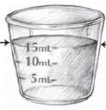
2021 AAP Policy Statement - Recommendation 2
Why?
  Oral syringes preferred for increased dosing accuracy; dosing cups error prone¹⁻³
    >3x increased odds of error with cups vs. oral syringes
    Risk of multifold errors with cups high for small-dose volumes
  Oral syringes especially recommended for¹⁻⁴
    <5-mL doses of medication
    Medications for young children
    Medications with narrow therapeutic windows
Encourage use of standardized dosing tools with all liquid medications
  Provide oral syringes when dosing accuracy is important
Dosing cup
Dropper
Dosing spoon
Oral syringe
Paul I. 2015; Yin HS, et al. 2016; Yin HS, et al. 2017; Beckett V, et al. 2012; AAP 2009.
37

Slide 38
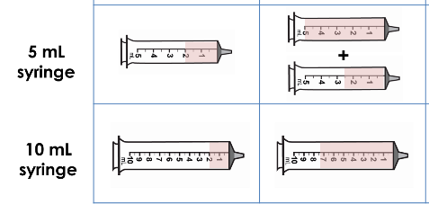
2021 AAP Policy Statement - Recommendation 2 (cont’d)
Provide dosing tools that are the smallest size to fit the dose
Why?
  Provision of dosing tools that more closely match prescribed dose volume reduces errors
    For 7.5-mL dose, 4x decreased odds of error with 10-mL syringe vs. 5-mL syringe
    Prevent the need for the caregiver / patient to fill an instrument multiple times for a single dose
    Not too large that there is a lot of room for overdosing
Yin HS, et al. 2017
38

Slide 39
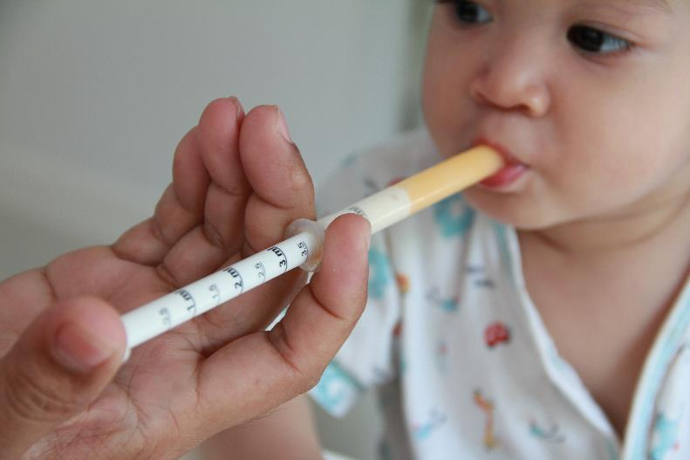

2021 AAP Policy Statement - Recommendation 2 (cont’d)
Encourage caregivers to
    Ask for a dosing tool with all prescribed medications
    Use their medication-specific tool each time medication is administered
Yin HS, et al. 2021
39

Slide 40
Gerald McEvoy, PharmD

Slide 41
NCPDP mL White Paper
Originally published 2014
Recommendations
  mL should be the standard unit of measure on prescription container labels of oral liquid medications
  Dose amounts should always use leading zeros before a decimal point and should not use trailing zeros
  Dosing devices with numeric graduations and units that correspond to the container labeling should be made easily and universally available
41
Notes:
Shonna handoff to Gerry

Slide 42
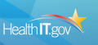

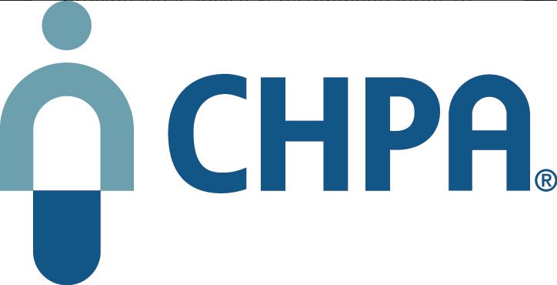
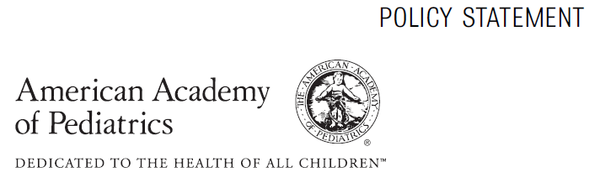

2014 NCPDP White Paper Catalyzed Additional “mL-Only Enforcement” Efforts Across Healthcare
Default must be mL for oral liquids in e-prescribing / EHRs
Teaspoon removed as an approved unit for package labeling
Updated OTC Industry Guidance to “use mL only”
AAP policy statement: “mL-based dosing should be used exclusively”
42

Slide 43
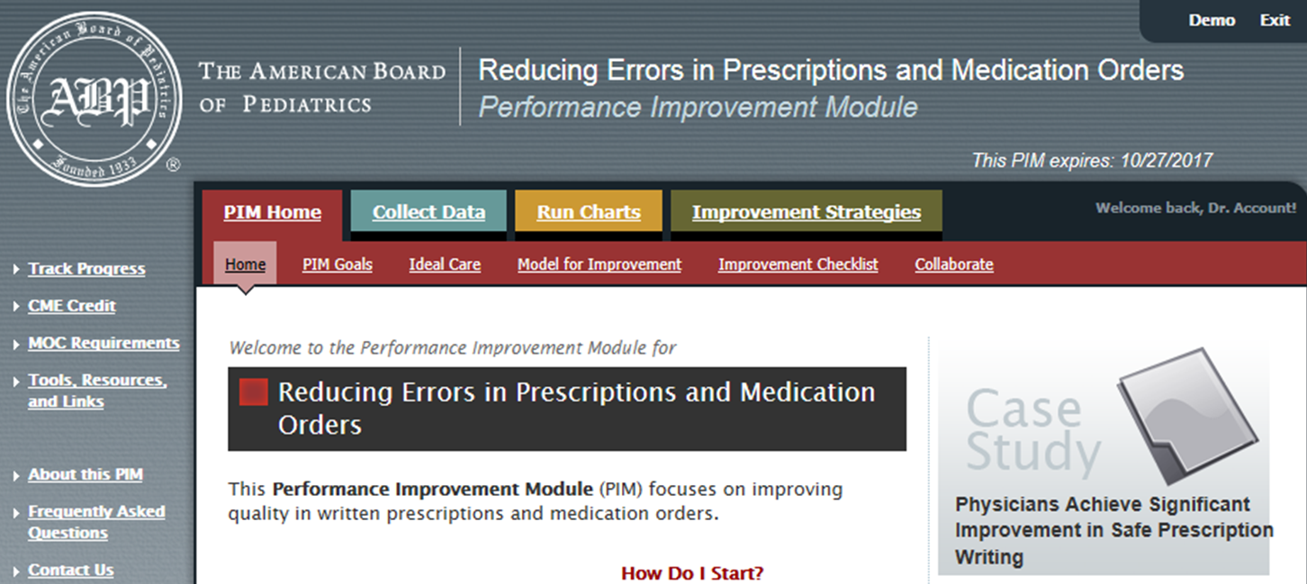
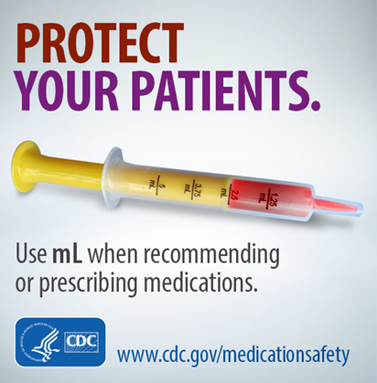
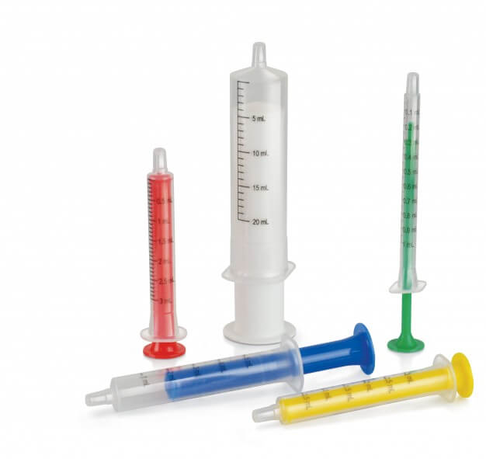
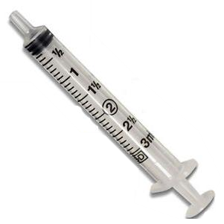
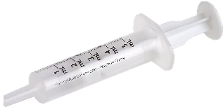
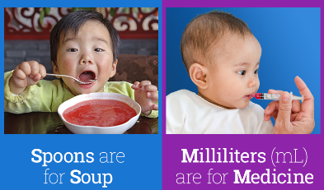
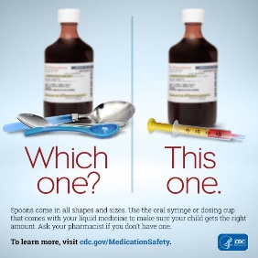
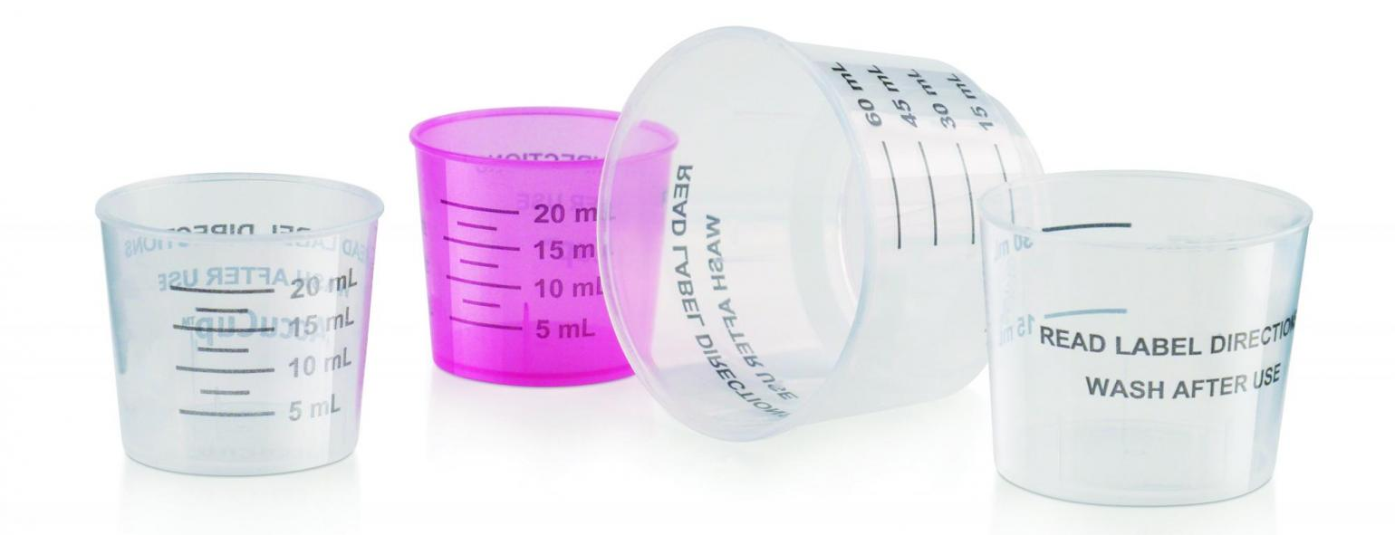

Catalyzed EDUCATION Catalyzed ENGINEERING
For Prescribers
For Patients/Caregivers
Encourage production of mL-only dosing devices
43

Slide 44
mL White Paper Update Version 2.0
NCPDP Task Group reactivated November 2017
  Since 2014, professional organizations, safety organizations, standards setting organizations, and federal health agencies have issued additional recommendations supporting metric standardization
  New research has provided further best practice guidance on the role of metric dosing designations
  New research has provided further best practice guidance on appropriately designed devices for oral liquid medication administration accuracy
  Therefore, NCPDP reactivated the task group to provide updated recommendations
44

Slide 45
NCPDP mL White Paper 2021 Update Version 2.0
Revise the initial mL white paper to reflect research and environmental changes surrounding use of mL for:
  volumetric measure in medication orders
  e-prescribing
  patient instructions and prescription container labeling
  optimal oral dosing devices
45

Slide 46
Areas of Revision Focus
Strengthen recommendation to promote universal adoption
Address new and revised authoritative recommendations
    USP retirement of teaspoon as official unit of measure (General Chapter <1221>)
  USP revisions to General Chapters <17> and <659>
  USP requires that prescriptions be written and dispensed in metric units
  ONC EHR certification requirement for mL only in e-prescribing with no option for override
    - Corresponding NIST e-prescribing standard
46

Slide 47
Areas of Revision Focus
ONC EHR Certification
  ONC addressed safety issue associated with non-metric dosing of oral liquid medications
  ONC EHR certification now requires that e-prescribing software present Sig options to prescribers that apply metric units only and must not permit prescriber override to use household units (e.g., teaspoon) instead
  This change was implemented to support more precise prescription dosing and thus reduce dosing errors and improve patient outcomes and now aligns with other federal partners (including FDA and CDC)
47

Slide 48
Areas of Revision Focus
  AAP and AAFP policies on standardized mL dosing and metric-only dosing devices (preferably syringes)
  APhA policy for metric-only labeling and measurement of oral liquid medications, including dosing devices
  ABIM Foundation Choosing Wisely: ASHP’s recommendation that oral liquids be prescribed and administered only as mL using approved dosing devices
  FDA guidance for product design to minimize medication errors
  FDA Guidance for Industry that dose expression should be in metric units of measure such as mL
48

Slide 49
Areas of Revision Focus
  CHPA guideline that mL should be the only unit of measure in dosing directions for oral liquids
  ASHP policy on SI (e.g., mL) units for patient- and medication-related measurements
    Use clinical decision support systems, equipment, and devices that allow input and display of SI units only
    HIT manufacturers should use only SI units in product designs and patient- and medication-related measurements
    Promote education on use of SI units and their importance in preventing medication errors
49

Slide 50
Areas of Revision Focus
  NCCMERP enhanced accuracy of prescription writing
    - Express oral liquid doses using only metric weight or volume
  NABP endorses use of mL and supports pharmacists exercising their professional prerogative to select mL as standard unit of measure
Incorporate new research findings
  - Preference for oral syringes vs cups
  - Preference for appropriate device volume relative to dose
Include additional ISMP case reports
Survey chain pharmacies concerning adoption of original 2014 recommendations
50

Slide 51
Community Survey Dosing Policies for Oral Liquids 2019
Assess community pharmacy policies and practices regarding use of metric (mL) units for oral liquids
  31 chain companies representing 35,000+ pharmacies
  12 chain responses representing 15,000+ pharmacies
  Only 2 chains required mL only in dosing instructions
  Almost 50% recommended conversion to mL as preferred practice
    - but left to individual pharmacist judgment
  67% policy to provide appropriate device with every Rx
  83% policy to counsel on proper use of dosing device
  25% reported using system software to default to mL
  0% measure staff performance on recommended practice
51

Slide 52
2021 Revision Changes & Universal Adoption
NCPDP Recommendations for Standardizing the Dosing Designation on Prescription Container Labels for Oral Liquid Medications
1 | Milliliter (i.e., mL) should be the universal standard unit of measure used on prescription container labels for oral liquid medications. e-Prescribing software must not permit prescriber override for U.S. customary (household) units (e.g., teaspoon). Pharmacy systems should only generate dosing instructions for oral liquids in metric units.
2 | Dose amounts should always use leading zeros before the decimal point for amounts less than one and should not use trailing zeros after a decimal point on prescription container labels for oral liquid medications.
3 | Dosing devices with numeric graduations and mL units that correspond to the prescription container labeling should be made easily and universally available such as including a device each time oral liquid prescription medications are dispensed. Dosing devices should be of appropriate volume and graduated accuracy for the amount prescribed and should not use multiple units of measure (i.e., metric only not metric plus household). For volumes up to 10 mL, oral syringes generally are the preferred dosing devices.
52

Slide 53
Selecting Appropriate Dosing Devices
Provision of mL-only dosing devices that more closely match recommended dose volumes is important for reducing dosing errors
Dosing devices should be large enough to measure the full recommended dose (should not require multiple measurements for a single dose), but should not be too large
Provide guidance (e.g., through automated messaging) to help pharmacy staff select the most appropriate dosing device to accurately measure the volume of the prescribed dose.
  For administering doses 1 mL or less
    - Provide a 1-mL syringe
  For administering doses >1 mL to 5 mL
    - Provide a 5-mL syringe
  For administering doses >5 mL to 10 mL
    - Provide a 10-mL syringe
  For administering doses >10 mL
    - Provide a dosing cup or syringe of volume >10 mL or, if no larger volume dosing devices are available, instruct caregiver/patient on performing multiple draws with 10-mL syringe
53

Slide 54

Special Feature
NCPDP recommendations for standardizing dosing in metric units (mL) on prescription container labels of oral liquid medications, version 2.0
purpose. Best practices and guidance are provided for standardizing dosing instructions on prescription container labels of oral liquid medications by eliminating use of U.S. customary (household) units and adopting metric units universally, with the goal of decreasing the potential for error and improving safety and outcomes when patients and caregivers take and administer these medications.
Summary. Despite decades of best practice use of metric units in organized healthcare settings and advocacy by various professional societies, medica- tion safety experts, and standards setting organizations, use of household units (e.g., teaspoon) on prescription container labeling instructions for oral li- quid medications persists in community pharmacy settings. Five years after publication of the National Council for Prescription Drug Programs’ (NCPDP’s) original white paper advocating metric-only dosing, very few community phar- macy companies appear to require oral liquid dosing instructions be presented in metric-only units (mL). Error-prone dosing designations contribute to medi- cation errors and patient harm. Use of both multiple volumetric units (e.g., teaspoonsful, tablespoonsful) and multiple abbreviations for the same volu- metric units (e.g., mL, cc, mls; tsp, TSP, t) increases the likelihood of dosing errors. Opportunities for error exist with each administration of an oral liquid medication and, unless coordinated with dispensing of appropriate oral dosing devices and optimal counseling, can result in use of household utensils (e.g., uncalibrated teaspoons) or discordantly marked devices that can further ex- acerbate the risk of error. Since publication of NCPDP’s original white paper, new standards have been adopted governing official liquid volume representa- tion, calibrated dosing devices, and e-prescribing software which support the elimination of non-metric units to reduce use of dosing practices that are error- prone. In each case, U.S. customary (household) units have been eliminated in official standards and certification requirements. Therefore, use of non-metric units for oral dosing of liquid medications no longer is an acceptable practice.
conclusion. Key factors contributing to dosing errors with oral liquid medications include use of multiple volumetric units and abbreviations; failure to institute pol- icies and procedures that eliminate the use of non-metric (e.g., household) units and universally adopt metric-only dosing instructions in all settings; failure to co- ordinate dosing instructions with dosing device markings, appropriate type (oral syringe versus cup), and optimal volumes (e.g., 1-, 5-, or 10-mL devices); failure to adequately counsel patients about appropriate measurement and administration of oral liquid medication doses; and use or error-prone practices such as missing leading zeros and elimination of trailing zeros in prescriptions and container labels. Adoption of this white paper’s recommendations will align dosing designations for oral liquid medications in all settings with current standards and attain universal metric-only practice.
Keywords: Administration, Oral; Comprehension; Drug Labeling/Standards; Electronic Prescribing; Medication Errors/Prevention & Control; Parents; Pedi- atricians; Pharmaceutical Solutions/Administration & Dosage; Pharmacists; Physicians, Primary Care; Practice Guidelines as Topic; Syringes/Standards; Weights and Measures.
Am J Health-Syst Pharm. 2021;78:578-605
Supplementary material is available with the full text of this article at AJHP online.
Downloaded from https://academic.oup.com/ajhp/article/78/7/578/6153722 by Government user on 06 August 2021
Developed by National council for prescription Drug programs, Scottsdale, AZ
Copyright © 2021 by the National Council for Prescription Drug Programs (NCPDP). This document may be freely redistributed in its entirety provided that the copyright notice is not removed. It may not be
sold for profit or used in commercial
documents without the written permission of the copyright holders. This document is provided “as is” without any express or implied warranty. This document is also being published by the National Council for Prescription Drug Programs.
This document is also being published by the National Council for Prescription Drug Programs.
DOI 10.1093/ajhp/zxab023
578 aM J HealtH-SYSt pHarM | VOLUME 78 | NUMBER 7 | APRIL 1, 2021
54

Slide 55



CPE INSTRUCTIONS (On-Demand Version):
Harmonization of Dosing Designations for Oral Liquid Medications Across Acute & Ambulatory Care Settings
1
1
2
3
Redeem your credit online at
CEimpact.com
*If this is the first time you have utilized the CEimpact Learning Management System (LMS) you will need to create an account.
From the CEimpact.com Homepage – enter the code provided in the ‘Enter Code’ box and click SUBMIT.
Complete the Exam & Evaluation as prompted; click SUBMIT to send your information to CPE Monitor. Follow instructions to access your CPE Statement of Credit on CPE Monitor.
Click on My Courses. Then click on the Course Title in your Enrolled folder. Read the course instructions.
Pharmacist Code: uZ4eh5
Technician Code: J4GHhP
The deadline for obtaining your CPE Credit is 8/4/2025.
The deadline is non-negotiable due to CPE Monitor reporting policies.

Slide 56
Questions?

Slide 57

Save the Date!
Future HIMSS/NCPDP Townhall Sessions
August 25 @12:00pm ET – Biosimilar and Interchangeable Biological Products: An Overview of Scientific Concepts and Practical Resources
September 27 @ 12:00pm ET – Topic: Pharmacy Standards for Value-based Arrangements
57

Slide 58
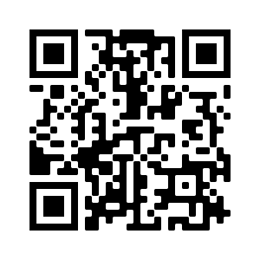

UPCOMING NCPDP WEBINARS:
COB Functionality in Telecommunication Standard Version D.0
Aug 11 at 12PM ET (Complimentary Webinar)
Telecom Re-envisioned - An Overview
Learn JSON’s Impact on the Telecom Standard, Aug 18 at 12PM ET
Fee: $50 Members; $150 Non-Members
State of the National Drug Code, Aug 30 at 1PM ET
Fee: $50 Members; $150 Non-Members
https://www.ncpdp.org/Webinars.aspx
58

Slide 59
SAVE THE DATE!
NCPDP’s 2022 Virtual Educational Summit
Telecommunication F6 & Related Standards: Prepare for Implementation
November 15-16, 2022
59

Slide 60

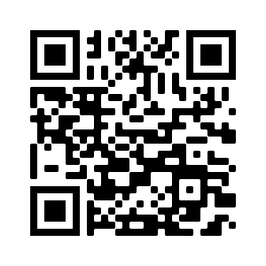
Call for Proposals for #NCPDP23,
“The Great Race to Close Gaps in Care” is Now Open!
View suggested topics and submit a proposal today: https://ncpdp.org/AC/call-for-proposals-info.aspx
60

Slide 61
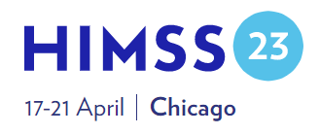

SAVE THE DATE!
HIMSS23 Global Conference
April 17-21, 2023 | Chicago, IL
Call for Proposals opens in August 2022
Registration opens fall 2022

Slide 62

Thank you.
Contact Gwynne Jelbaoui gwynne.jelbaoui@himss.org
312-638-9490

